Slide 1
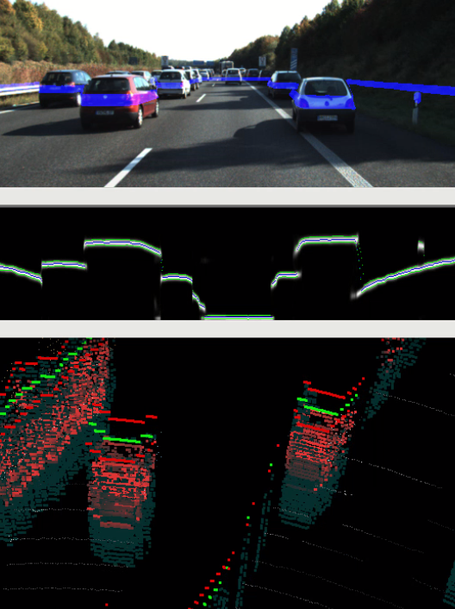
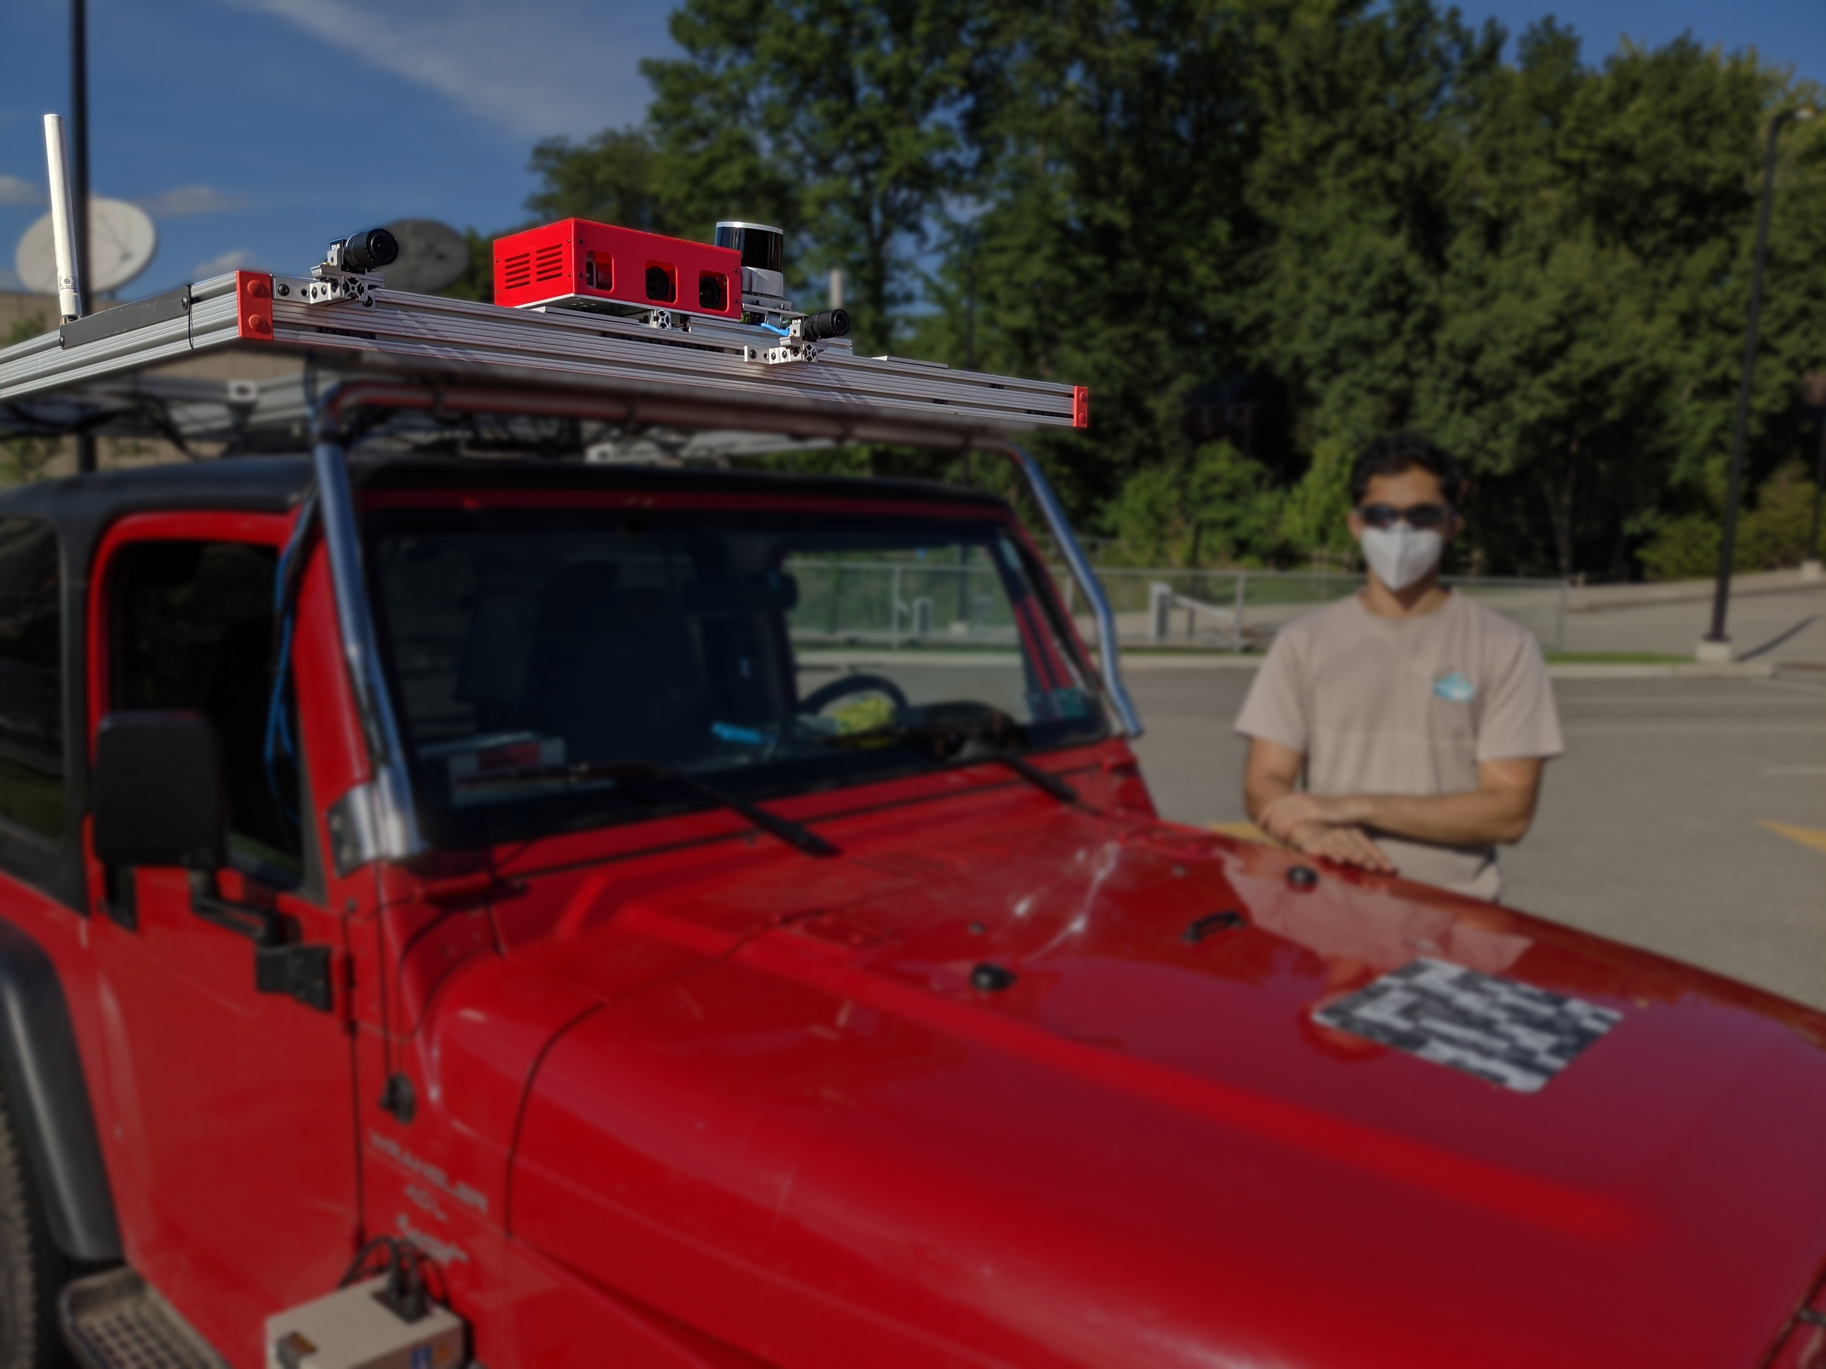
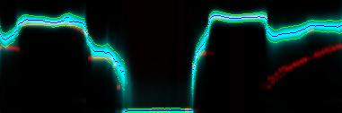
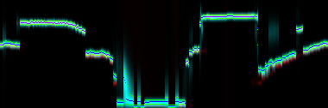
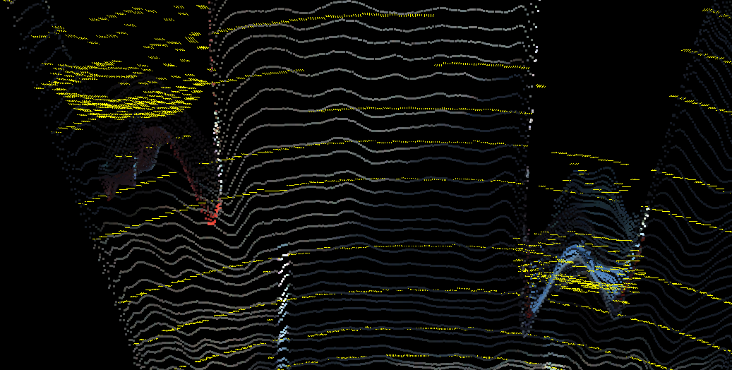
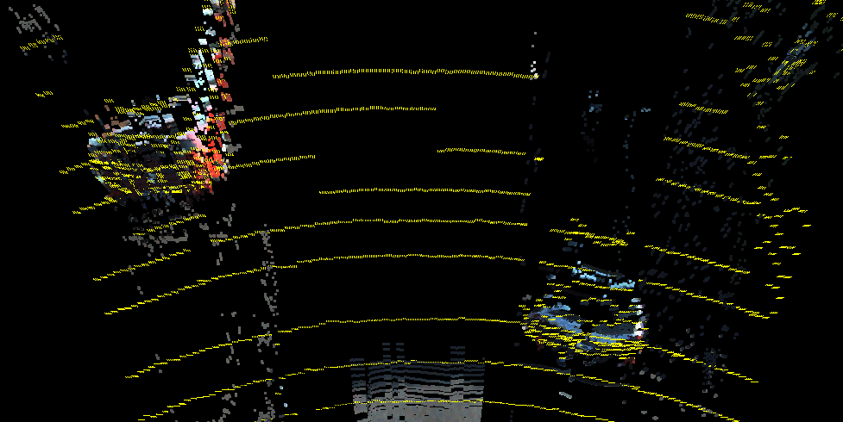
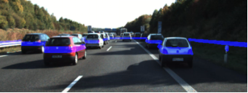
Per Pixel Depth Distribution Predicted from Monocular RGB
Used to Drive the Adaptive Light Curtain Laser
Pixel Depth corrected over Time from Light Curtain Measurements
Right
RGB
Light Curtain
GPS
Lidar
Left
RGB
Topdown Predicted Uncertainty in Blue
Lidar GT in Red
Adaptive
Laser
Line
Rolling Shutter
NIR
Lidar GT in Yellow
Expectation of Distribution produces pointcloid
Seen by Driver

